Slide 1
Movieo A Social Community for Movie Lovers
SSAD Team 10
Client : Srinivas Reddy ( ANIPR Tech. )
Student Mentor : Vishal Gupta
The Team : Jaipal Singh Goud
Umesh Singla
Punyaslok Pattnaik
Varshit Battu
Ram Kumar Reddy

Slide 2
What is Movieo ?
Movieo serves as a platform to bring together movie-lovers and create an integrated review and rating system which is not in any manner biased by a certain critic or professional.

Slide 3
About Our Project
Social community for Movie Lovers
Focuses on Movie Fans rather than critics
Consolidated movie viewing experience
Target Audience : Everyone

Slide 4
And there’s more...
Follow your friends’ views on a movie through integrated Twitter and Facebook feeds
Keep track of what’s trending
Get a wide variety of perspectives about a movie
Personalized information about what your friends or people around you think of a movie

Slide 5
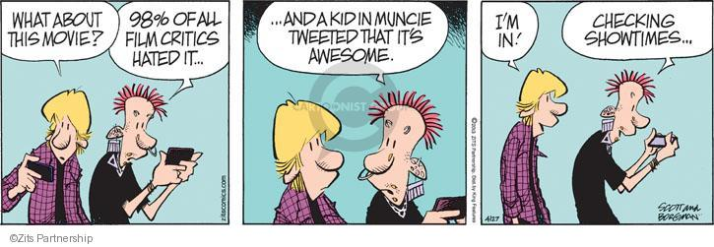
Why Movieo?

Slide 6
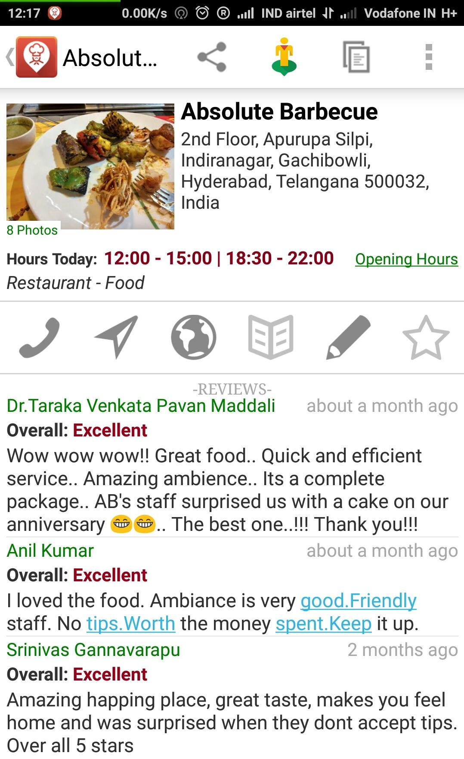
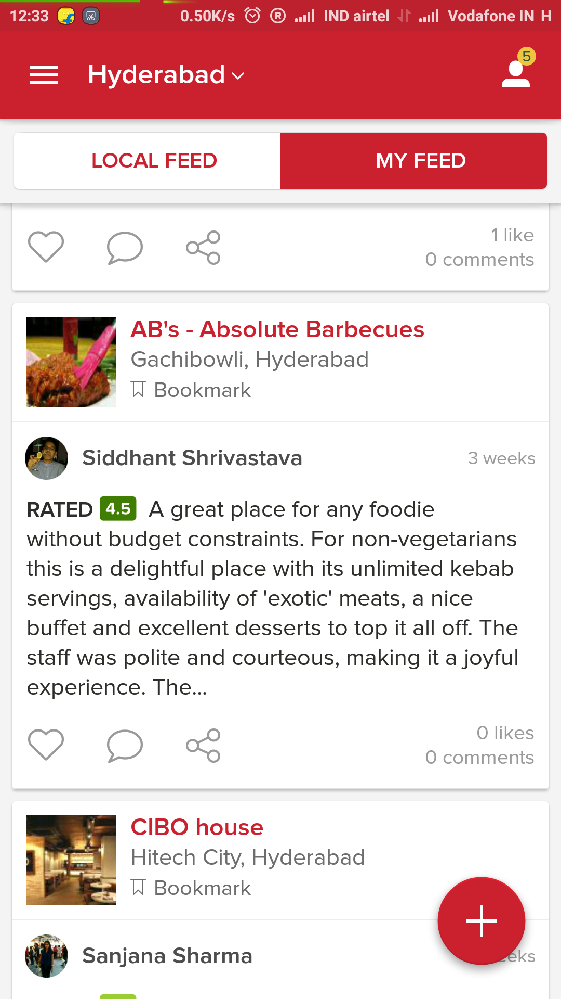
Which one would you prefer?
My Friends

Slide 7

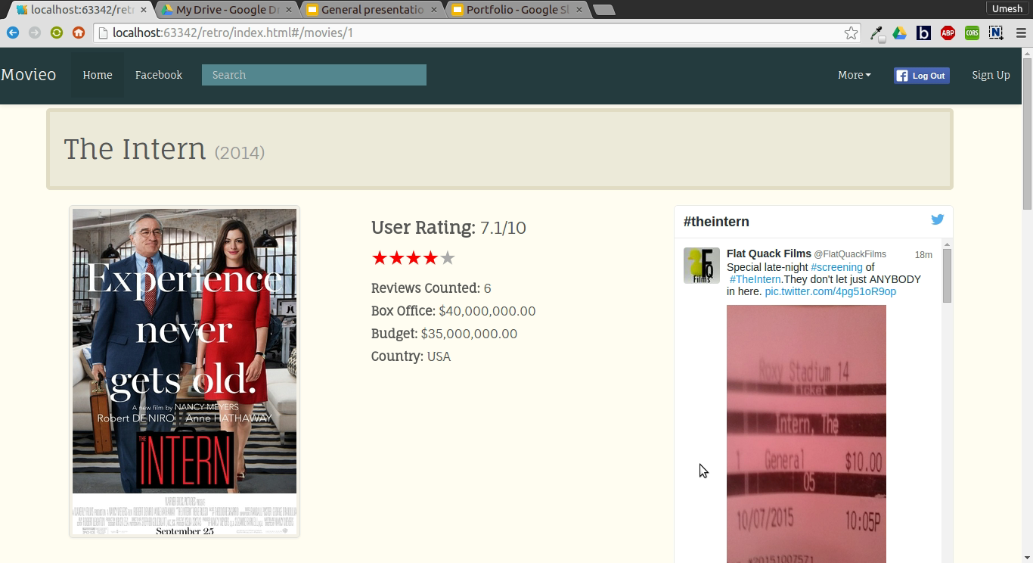

Multiple Platforms
Web App
Hybrid Mobile App
Android
iOS
Windows

Slide 8
Technologies Used
APIs : Twitter, Facebook, FireStorm
Web-Dev : Django (Rest Framework), MySQL, AngularJS, Beautification
Mobile-Dev : Java ( Android ), Cordova-Ionic ( Cross-Platform )

Slide 9
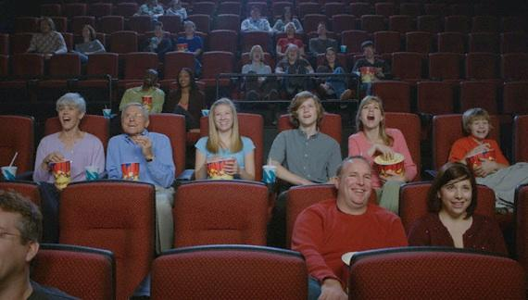
Who will use Movieo ?
EVERYONE!

Slide 10
What can a User do ?
Review, rate and share any movie
Comment, share, upvote and downvote others review
Publish review on Facebook timeline
Follow friends and invite friends to write a review
Earn badges based on number of upvotes
Create custom lists
Update the movie info (admin approval needed)

Slide 11
What can the Admin do ?
Add, edit and delete movies
Configure cast profiles
Approve user submitted info update and quote requests
Manage the photos and videos for each movie

Slide 12
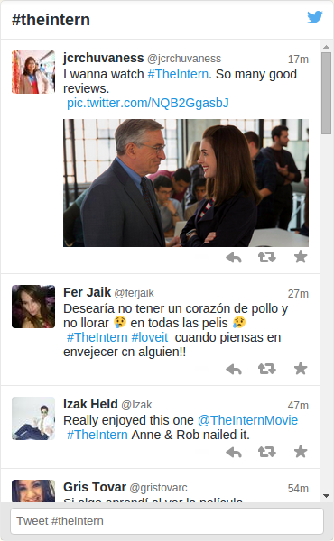
Live Updates from Social Media
Tweets from different people over the world.
Posts from public page of the movie.
Reviews in the database may not be genuine or may be biased.

Slide 13
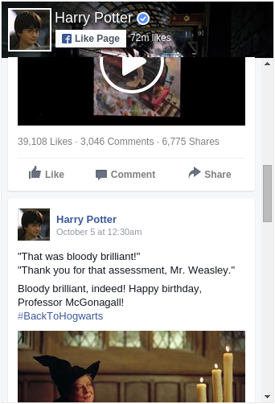
At Personal Level
Minimal Commercial Influence
User Generated Content instead of Critics dominating the rating system

Slide 14
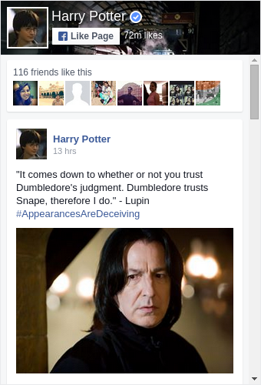
At Personal Level
Remain connected to your Friends, Relatives and other people around you.
Follow your friends on Movieo and see what they post about a movie.
Post your reviews to Facebook Timeline and let others read your reviews.

Slide 15
Progress so far
We have a working model of a Movieo web app with a limited number of features like searching, displaying movies according to date of release etc and integrated the tweets from twitter which are searched by the hash tag as the movie name

Slide 16
Releases
Release 1:
Learn Rest APIs concept
Database ready
Store popular and verified tweets in database using hashtags/keywords
App and website UI in progress
Admin can add, edit and delete movies, cast profiles and related media
Release 2:
User comment on review
User badge algorithms
Review preference algorithms
Personalized movie feed
Connect mobile app with backend
Invite friends to review and Check In with friends

Slide 17
Thank You

